Slide 1
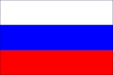
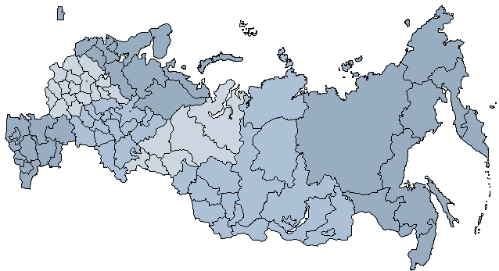
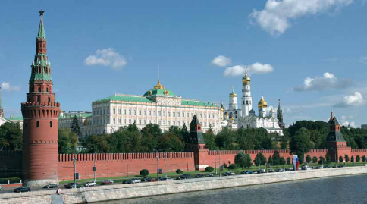
Investment Climate and Opportunities in Russia
Georgy G. Petrov
Vice-President
Chamber of Commerce and Industry
the Russian Federation

Slide 2
Russia’s Foreign Investment–Relevant Essential Highlights
Following a 4-percent growth in 2010, Russia’s GDP is estimated to rise by 4.2 % this year (official outlook);
Yearly consumer price indices: 8.8 % (2009), 8.8 % (2010), 6.5-7.5 % (2011, official outlook);
Relatively small foreign debt of Russian state institutions – USD 34.0 billion (as of April 1, 2011);
Ongoing climb in gold and currency reserves: USD 439.5 billion (01.01.2010)-> USD 479.4 billion (01.01.2011) -> USD 521.1 billion (01.06.2011);
Reserve Fund: USD 26.6 billion (01.06.2011);
National Welfare Fund: USD 92.5 billion (01.06.2011);
Sovereign credit ratings: Baa2 (Moody’s), BBB+ (Fitch), BBB+ (Standard & Poor’s);
Russia’s cumulative total foreign investment: USD 300.1 billion (as of December 31, 2010), USD 301.1 billion (as of March 31, 2011);
Russia’s cumulative FDI: USD 116.2 billion (as of December 31, 2010), USD 120.3 billion (as of March 31, 2011).

Slide 3
Russia’s Total Foreign Investment Cumulative Yearly Trends

Slide 4
Russia’s FDI Cumulative Yearly Trends

Slide 5
Russia’s Cumulative Total Foreign Investment Sectoral Breakdown

Slide 6
TOP-10 Foreign Investor Countries in Russia’s Cumulative Total Foreign Investment
source: R.F. Federal Statistics Service | Cumulative Foreign Investment, as of March 31, 2011
 | Total, USD billion | Share in Total, %
Total | 301.1 | 100
including:
Cyprus | 64.2 | 21.3
Netherlands | 41.7 | 13.9
Luxemburg | 34.0 | 11.3
Germany | 27.9 | 9.3
China | 26.7 | 8.9
Great Britain | 20.7 | 6.9
Ireland | 12.8 | 4.2
Japan | 9.2 | 3.0
France | 8.5 | 2.8
USA | 7.1 | 2.4

Slide 7
Russia’s Cumulative FDI Sectoral Breakdown

Slide 8
TOP 10 Foreign Investor Countries in Russia’s Cumulative FDI
source: R.F. Federal Statistics Service | Cumulative FDI (as of December 31, 2010)
 | Total, USD billion | Share in Total, %
Total | 116.2 | 100
Including:
Cyprus | 44.7 | 38.5
Netherlands | 22.4 | 19.3
Germany | 9.3 | 8.0
Virgin Islands | 4.1 | 3.5
Great Britain | 3.5 | 3.0
USA | 3.3 | 2.8
Switzerland | 3.2 | 2.8
France | 2.9 | 2.5
Austria | 2.4 | 2.1
Finland | 2.0 | 1.7

Slide 9
Russia’s Investment Attractiveness Highlights
High investment profitability;
Rapidly-growing consumer market;
Highly-skilled manpower;
Vast national resources;
Planned WTO entry .

Slide 10
Foreign Investors’ Rights Enforcement Aspects
Federal Legislation:
Federal Law on “Foreign Investment in the Russian Federation”;
Mutual investment promotion and protection agreements with other countries.
Regional Legislation:
Laws, adopted by most regional administrations to enhance investment moves by the means of corresponding incentives;
Investment councils, established by regional governors in an effort to facilitate investment activity.

Slide 11
Russia’s Investment Climate Improvement Trends
Simplifying construction permit process;
Removing infra restrictions;
Simplifying employment of high-skilled foreign manpower for work in Russia;
Improving customs regulations;
Modifying taxation system;
Raising efficiency of judicial system;
Carrying out privatization of state-shared companies;
Easing and reducing administrative regulations.

Slide 12
Foreign Investors’ Complaints Treatment Aspects
The R.F. Ministry of Economic Development assigned with timely considering foreign investors’ complaints;
The First Vice-Chairman of the Russian Government Mr. Igor I. Shuvalov appointed Ombudsman in charge of investment issues;
The Consultative Council for Foreign Investment tasked with effectively handling investors’ problems.

Slide 13
Russian Direct Investment Fund
The Russian Fund of Direct Investment is being currently set up in Russia by the Federal Government, represented by the VneshEconomBank, a state-owned one;
The main purpose of the fund to be achieved is inducing foreign investment by sharing risks with foreign investors through joint investment in projects of various fields, except the mineral resource sector;
As a result, from USD 60 up to 90 billion are estimated to be gained by Russia over the next five years.

Slide 14
Modernization and Technological Renovation Strategy
Main priorities:
Energy efficiency and resource saving;
Nuclear technologies;
Computing technologies and software;
Space technologies and telecommunications;
Medical equipment and pharmaceutical industry.

