Slide 1

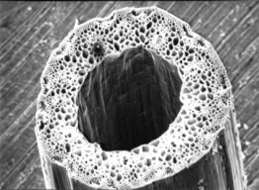
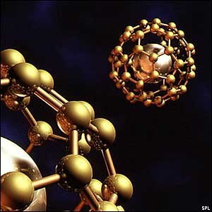
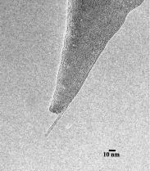



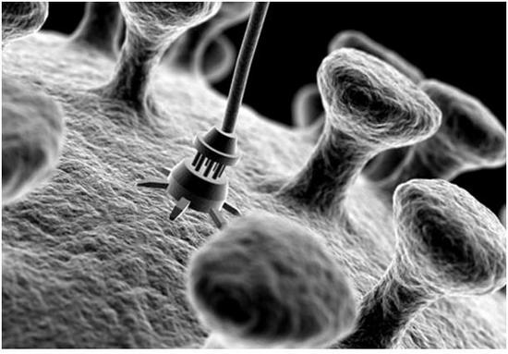
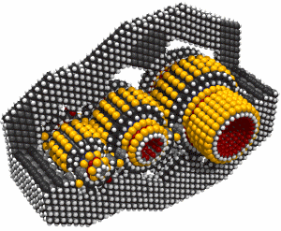
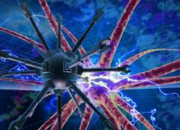
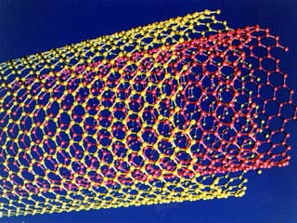
Examples of successful joint Russian – Korean high – tech projects
June 2011

Slide 2
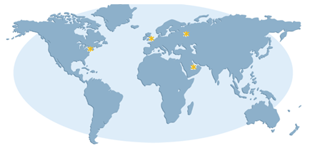

I2BF Global Ventures
A seasoned clean technology fund manager
Established in 2005, I2BF is an international clean technology asset management group with a global investment mandate, focused on venture capital and public equity activities in the United States, Europe and Asia
I2BF manages close to USD 100 million¹ across its flagship clean tech focused venture fund which has invested over USD 75 million to date and a hedge fund with close to USD 24 million in AuM.
Headquartered in London I2BF has offices in Moscow, London, New York and Dubai
I2BF is determined to provide significant value to each of portfolio companies. All team members are committed to helping entrepreneurs grow and succeed
I2BF analysts use only the best information and deal sources in the new energy industry as well as proprietary relationships built over years of investing activity
I2BF knows that it takes more than financial support to get a business to the top and therefore always provides management input, partnership opportunities, and foundations for strategic alliances – everything to ensure that the companies are built faster, broader, and with less risk
I2BF Global Ventures
I2BF Venture Capital | I2BF Arbat Clean Technology Fund
A diversified clean technology focused venture capital fund with investments in 15 portfolio companies globally across the renewable energy, energy storage, energy efficiency, and “green” technology sectors Co-investors include well-recognised VC groups as well as strategic investors such as Khosla Ventures, Impax Group, WHEB Ventures and Goldman Sachs AuM USD 75 million | A systematic quantitative long/short equity hedge fund launched in 2008 which seeks to provide superior risk adjusted returns in the renewable energy and clean technology space Utilising proprietary models, the fund aims to outperform conventional renewable energy benchmarks. Most Innovative Product award at the Hedge Funds Review European Performance Awards 2010, returning 35.78% net in 2009 AuM USD 24 million
Worldwide offices
London
Moscow
New York
Dubai

Slide 3


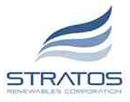





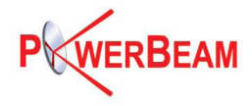




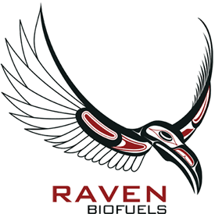
I2BF: An Experienced Investment Manager
Over USD 75 million invested in clean technology private equity
Since its first investment in 2006, I2BF Holdings I has made investments into15 companies for over USD 75 million¹
Overview of portfolio by number of deals
Overview of portfolio by investment amount (USD)
¹ As at 30 September 2010. “I2BF Holdings I” collectively refers to the holdings of and investments made, sourced or managed by I2BF Holdings Limited, a British Virgin Islands company, its affiliates and associated funds and entities.

Slide 4
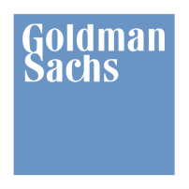

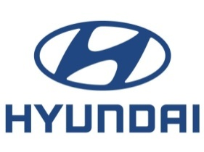
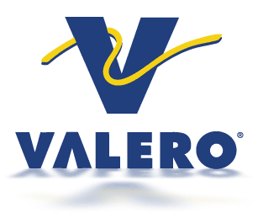


I2BF is jointly invested with leading strategic industry and financial investors
Market-leading investors in the cleantech space with over USD 1 billion under management
One of the world’s leading investment banks with a long-standing history of investment in renewable energy and cleantech.
The world’s fourth largest automaker in terms of units sold and one of the Big Asian Four (with Toyota, Honda and Nissan).
The largest oil and gas refiner in North America (Market Cap: USD 9.5 billion)
Impax Asset Management as of June 2009 has assets under management and advisory of over USD 1.8 billion for institutional and private investors, with a focus on the environmental and cleantech sectors
One of the world's leading venture capital firms focused on information technology and healthcare investments.
NEA has over USD 8.5 billion AuM

Slide 5
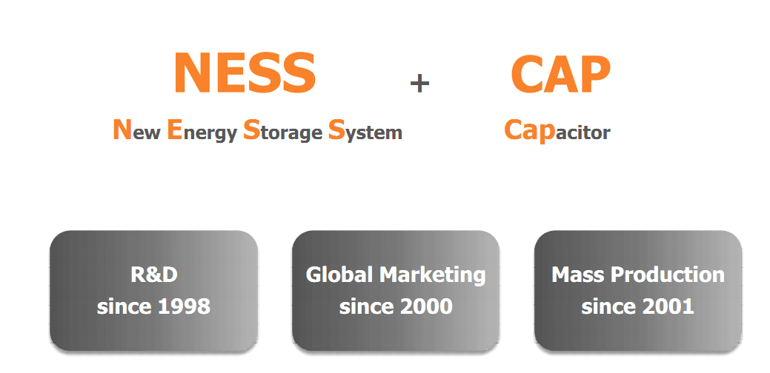
Nesscap - introduction

Slide 6
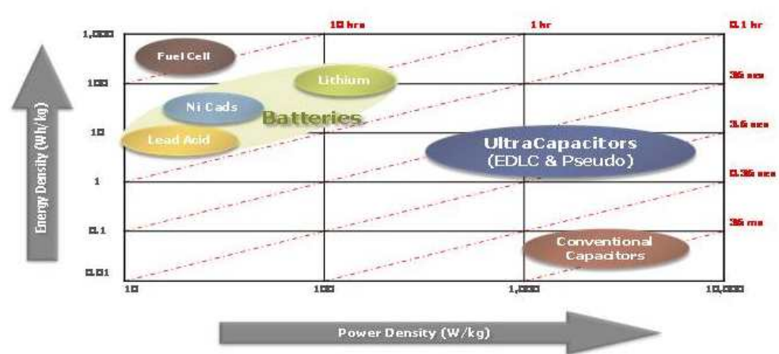
Ultracapacitor - introduction

Slide 7
Ultracapacitor – key application areas
Automotive Market (2011~)
Consumer Market (2005-2006)
Long Term Commitment
Short Term Revenue
Hybrid Bus/Truck
Regenerative Brake
Diesel Starting
Voltage Stabilization
Stop & Go System
μ− Hybrid
Mild Hybrid
Full Hybrid
Fuel Cell Car
Fuel Cell System
- Mobile Charger
Solar tiles
Remote Controller
Water/Electric/Gar Meter
Wireless Application (motorola)
Toys
Audio (amplifier..)
Yard Cranes
Train/Trams
Intra Building Train
UPS
Engine Starter
Windmill
Postal System
Welding Machine
Military/Aero application
Power Application (2009~)
Solution Provider

Slide 8
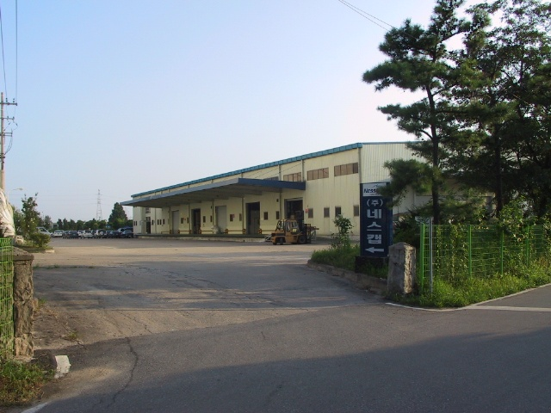
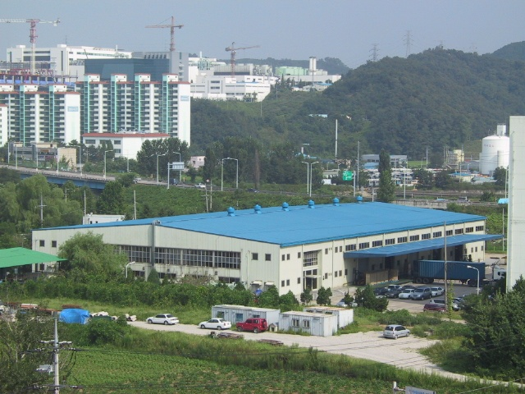
Nesscap – Staff and Facilities
Convergence of Manufacturing & Offices
Located at Giheung site since yr’ 2004
Designed and developed by Nesscap

Slide 9
Nesscap – I2BF: history of collaboration
I2BF has always regarded an energy storage space and specifically new-
generation devices as an extremely promising one.
Throughout our research process we have analyzed tenth of ultracapacitor
companies all over the world, however never saw the technology suitable
for mass production and potential for cost reduction
I2BF first contacted NESSCAP in mid – 2009, made few phone calls, made a site
visit made a thorough due diligence process, talked to NESSCAP customers.
Initial impression was very positive, we concluded that technologywise
NESSCAP has a potential to become one of the world leading players
At the same time, we realized that we couldn’t make really “big thing” out of
a local player, part of the strategy was to expand globally and offer new
solutions at new markets

Slide 10
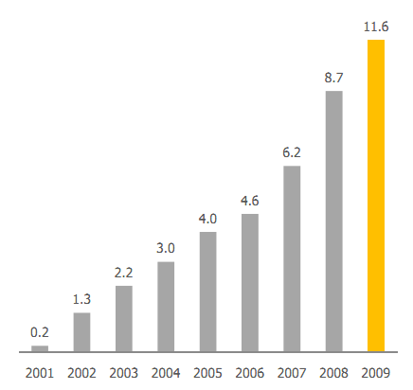
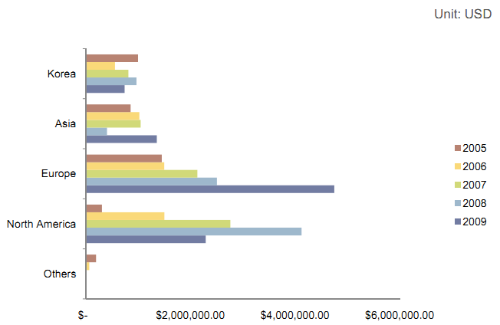
Nesscap business dynamics
Revenue dynamics
Transformation to global company

Slide 11
Nesscap listing on TSX
Reasons to go public
- Access to new funding
- Brand enhancement on the core market of North America
- Liquidity and fair valuation of assets
Choice of the stock exchange
- AIM – bad dynamics of largest companies lack of liquidity
- NASDAQ: OTC – perfect fit, however, too expensive as of now
- HSE - far away from the target markets
- TSX – optimal investor based, targeted at small – cap companies

Slide 12
Nesscap and Russian market
Core NESSCAP strength
- production process engineering
- scaling up production
- quality control
- marketing
Expertise, that could be found in Russia
- solution engineering
- basic material science
- new types of energy storage devices
Introduction of fundamental research capacity to Nesscap engineering expertise
could have a synergetic effect with a potential to create one of the top industry players

Slide 13
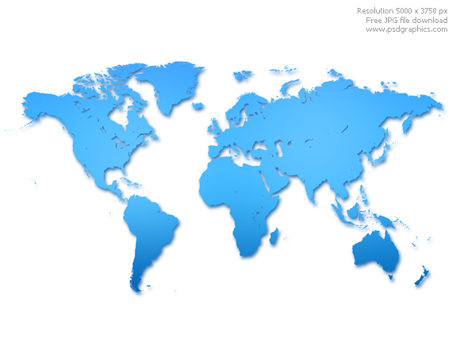
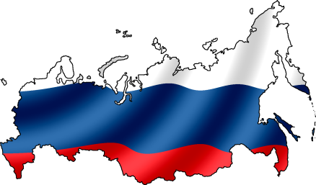
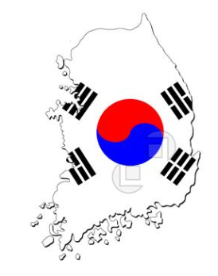
Potential for Russia – Korea collaboration
Significant scientific base, retained from the former USSR that remains largely untapped since the lack of venture funding in post-Soviet era
Korea’s labs, universities and startups are the source of innovative technologies in LEDs, energy storage, fuel cells, nuclear and transportation
High-level government support for innovations, access to tax-exempt jurisdictions created in both
countries
Dynamic financial markets, facilitating exit of early stage investors through IPO (3 VC - backed IPOs during H1 2010 in Russia)
Unprecedented investment flow into high-tech industry from grant programs and state – owned VC/PE
funds (Rusnano, RVC, Skolkovo, Regional funds, $84bn cleantech stimulus in Korea)

Slide 14
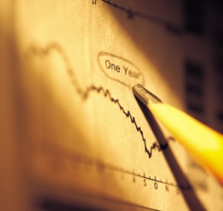
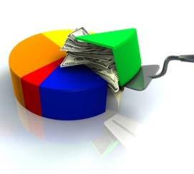
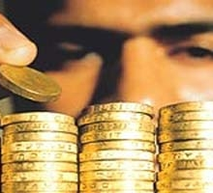

Russinan – Korean Nanotechnology Fund
Early stage – start up or early expansion
USD 5 million-10 million
Preferred equity or convertible debt
20% - 40% stakes in individual companies
BOD participation
IRR minimum 30%
Investment Types and Size
Coatings
Energy storage
Solar sector
Catalyst
Water treatment
Sector Focus
Total number of portfolio companies not to exceed 20
Total investments into one company will not exceed USD 10 million
Investment in one single round will not exceed USD 5 million
Investment Parameters
Russia
South Korea
Geographic Focus

Slide 15
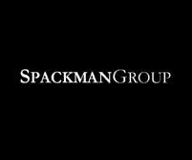
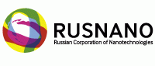
Strategic Partners
RUSNANO participates in building nanotechnology infrastructure, which includes the nanotechnology centers of excellence, business incubators and early stage investment funds. RUSNANO provides scientific and educational programs that are required for its investment projects to succeed, and also supports the popularization of nanoscience and nanotechnology. RUSNANO selects promising spheres for investment based on longer-term foresight created by the leading Russian and world experts.
To assist the Russian nanotechnology industry advance to the global market and strengthening of its international links, RUSNANO develops partnerships with the leading nanotechnology centers in the world and organizes the annual Nanotechnology International Forum in Russia.
SPACKMAN GROUP is a diversified investment holding company. Established in 1997 and led by founder Charles Spackman, the Group oversees over US$1.3 billion in proprietary assets, mostly comprised of ownership interests in a portfolio of privately-held and publicly-traded companies, as well as investments in other specialized asset categories.
The Group invests proprietary capital and through various affiliates, subsidiaries, and structured investment companies. The primary objective is to acquire and build a diverse portfolio of businesses and assets that have potential for exceptional and consistent growth in value.
Regulatory, technical and research support from Russia’s leading nano technology investment and research arm

Slide 16

Why Nanotechnology?
Nanotechnology has shifted from the discovery phase, dominated by research, to the commercialization phase, where products are rapidly becoming available. Its impact is being seen in fields from medicine to energy and manufacturing.
The global nanotechnology market is projected to grow at a CAGR of over 18% during 2010-2013. By 2014, USD 2.6 trillion in global manufactured goods will incorporate nanotechnology.
The Asia-Pacific region will experience the fastest growth in the market for nanotechnology enabled goods at a CAGR of nearly 52% between 2007 and 2013. The recent move by the emerging markets such as South Korea and China to concentrate on nanotechnology Research and Development (R&D) will continue to play the most prominent role in the growth of nanotechnology.
Venture funding in nanotechnology may have peaked in 2008, when a record USD 1.4 billion was poured into startups. After a 42% drop in 2009, venture funding in nanotechnology is bouncing back.
Companies active in nanotechology need to pay close attention to nanomaterial environmental, health, and safety (EHS) issues and to manage both real and perceived risks while keeping ahead of regulatory environment. We believe the challenges are manageable.

