Slide 1
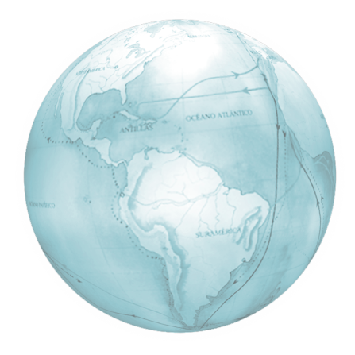
a
RUSSIAN
SPECIAL ECONOMIC ZONES:
NEW INVESTMENT OPPORTUNITIES
Alexander Temkin,
JSC “Special Economic Zones”
Moscow 2011

Slide 2
Special economic zones in Russia
Industrial zones
Touristic and recreational zones
Technology and innovation zones
Port zones
Kaliningrad Region
Moscow Region
Sverdlovsk Region
Moscow
Ulyanovsk
Tomsk
Murmansk
Moscow
Republic of Tatarstan
Togliatti
Russkiy island
St. Petersburg
Republic of Altai
Republic of Buryatia
Lipetsk Region
Altai Region
Irkutsk Region
Khabarovsk Region
The North Caucasian federal district
Stavropol Region
Notes:
A Special Economic Zone is a part of the Russian Federation territory determined by the Russian government with exclusive terms and conditions for business:
Successfully used in Russia since 2005 as a mechanism for attracting foreign direct investments
Total of 24 special economic zones of four types including:
four industrial special economic zones
four special economic zones for innovation
13 special economic zones for tourism and recreation
three port special economic zones

Slide 3
Key terms and conditions for Russian SEZ resident investors
Special administrative regime
Onsite dealing with governmental authorities, Single window approach
Free customs zone regime
No import duty, refundable VAT
R&D centres
State guarantees and stability
Investment agreement with the Government, zones are created for 20 years (49 years for port zones)
Ready-to-use infrastructure
Office facilities, gas, water, energy etc.
Tax incentives
Reduced profit tax rate. Property, land and transport tax exemption for up to 10 years. Reduced social insurance tax rate for innovation zones
Transparent legislation and administration
Highly trained staff
Support from the Government and JSC “Special Economic Zones”
Notes:
A Special Economic Zone is a part of the Russian Federation territory determined by the Russian government with special terms and conditions for doing business:
Successfully used in Russia since 2005 as a mechanism for attracting foreign direct investments

Slide 4
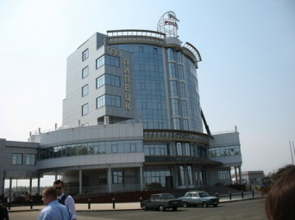
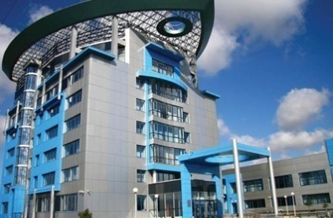
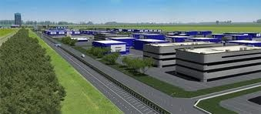
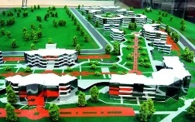
Special economic zones in Russia Industrial zones
Lipetsk Region
Total area – 1 027 hectares
Focus industries:
chemical industry
construction materials
electric and energy machinery construction
domestic appliances and trade equipment
Key advantages:
situated in the center of most developed European part of Russia
situated in the center of Russia’s largest steel production and metal-processing cluster
Republic of Tatarstan
Total area – 1 997 hectares
Focus industries:
automotive industry
construction materials
FMCG
chemical and petrochemical industry
Key advantages:
advantageous geographical and transport location
situated in the centre of Russia’s largest automotive cluster
Samara Region
Total area – 660 hectares
Focus industries:
automotive industry
transportation equipment
machine tool building
precision engineering
Key advantages:
long-time traditions of machinery & equipment construction
highly-qualified workforce
Sverdlovsk Region
Total area – 721 hectares
Focus industries:
automotive industry
medical technologies
chemical industry
aircraft construction, shipbuilding, rocket science
Key advantages:
industrialized region
rich natural resources

Slide 5
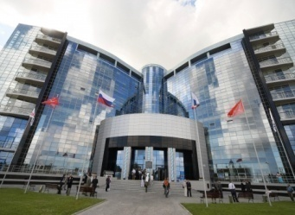
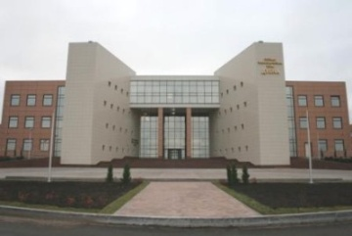
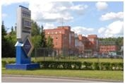
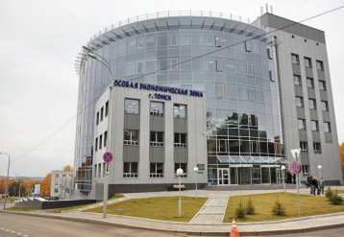
Special economic zones in Russia Innovation zones
St. Petersburg
Total area – 129 hectares
Focus industries:
instrument engineering
medical technologies
electronics
nanotechnologies
information and communication technologies
Key advantages:
Saint-Petersburg – Russia’s second largest city
high concentration of scientific and educational institutions
Dubna
Total area – 188 hectares
Focus industries:
nanotechnologies
biotechnology
nuclear technologies
information technologies
electronics & communication
Key advantages:
proximity to Moscow
high degree of education: 30% population involved in science-related sectors
Zelenograd
Total area – 147 hectares
Focus industries:
information technologies
nanotechnologies
microelectronics and optoelectronics
bioengineering and biosensor technologies
Key advantages:
proximity to Moscow in an established science centre
access to ample supply of highly-qualified labor force
Tomsk
Total area – 207 hectares
Focus industries:
communication equipment
medical technologies
information technologies
electronics & instrument engineering
Key advantages:
one of the largest educational centers of Russia
a diversified science centre

Slide 6
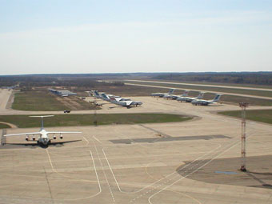
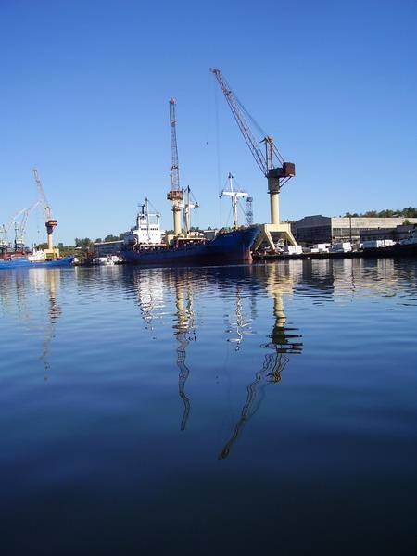
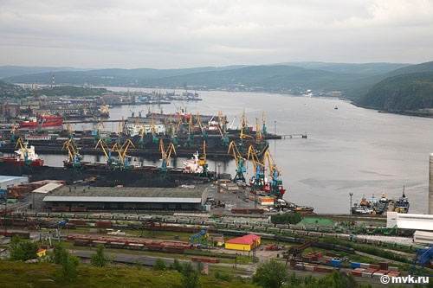
Special economic zones in Russia Port zones
Ulyanovsk port zone
Total area – 290 hectares
Focus industries:
aircraft MRO
aircraft re-equipment, conversion, assembling
logistics
pilot training (to be considered)
Key advantages:
located in the centre of the European part of Russia
focus on increasing demand for foreign-made aircraft MRO in Russia and CIS countries
well-trained and highly skilled local personnel
Sovetskaya Gavan port zone
Total area – 120 hectares
Focus industries:
port operations (cargo handling,
bunkerage, ship repair yards)
logistics
seafood processing
Key advantages:
focus on Asian – Pacific region rapid development
natural harbor and available land plots for development
potential increase of railroad capacities
potential development of mining and wood processing industries in adjacent regions
Murmansk port zone
Total area – 3,050 hectares
Focus industries:
port operations (cargo handling, bunkerage, ship repair yards)
logistics
seafood processing
Key advantages:
existing deep-water port with access to North and Trans-Arctic sea routes
natural harbor and available land plots for development
potential demand for port facilities and inland bases for the Arctic oil field development and servicing
potential expansion of railroad connections

Slide 7
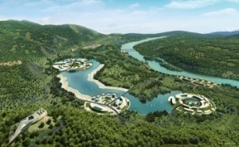
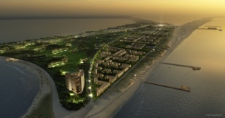
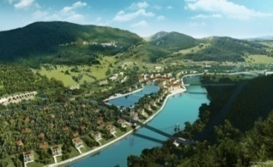
Special economic zones in Russia Touristic and recreational zones
Total zones area – 8,262 hectares
Focus industries:
sport and extreme tourism
cultural entertainment
recreational tourism
business tourism
ecological tourism
sea resort
spa resort
balneology resort
Key advantages:
unique natural and ecologically clean areas including those in Altai, lake Baikal and others
consistently increasing flow of domestic tourists
rising interest of foreign tourists to unexplored Russian territories from foreign tourists

Slide 8
Investors in SEZ (total committed investments €7+ bln)
Number of investors in special economic zones
31 investor
in tourist zones
33 investors
in industrial zones
197 investors in innovation zones
Including 34 foreign companies from 19 countries

Slide 9
Contacts
Alexander Temkin Deputy CEO
atemkin@oao-oez.ru
JSC “Special Economic Zones”
www.oao-oez.ru

